Slide 1

WEEK 8
CESAR A. PASCAL

Slide 2
This week, my plan was to continue advancing the web-based implementation of the G1 simulations, following the progress established in the previous week. The focus remained on refining the deployment and improving accessibility through a browser-based environment.

Slide 3
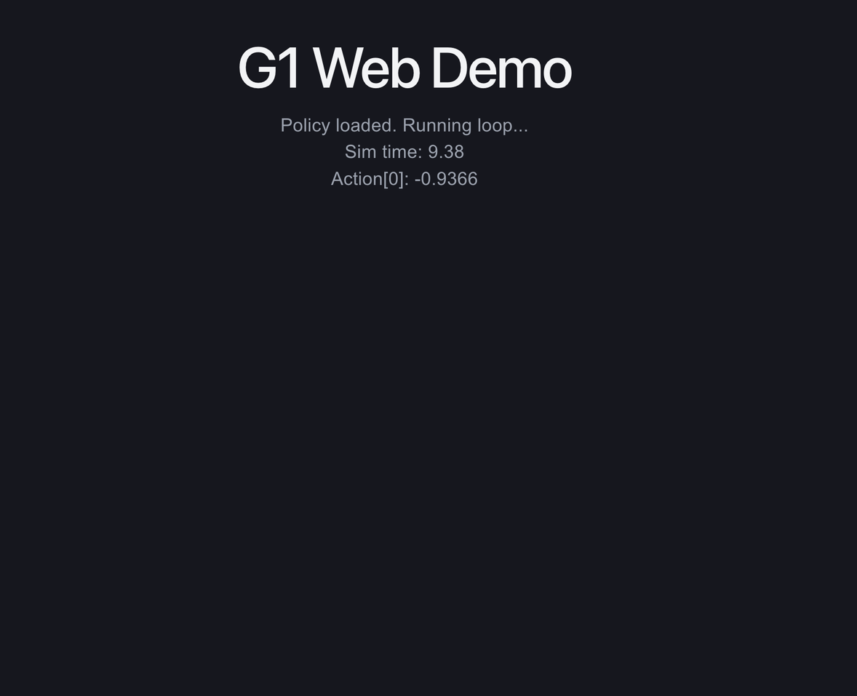
I observed that the policy implementation is relatively straightforward, as it primarily involves converting the trained model into ONNX format for compatibility with the web environment, rather than relying on a Python-based execution pipeline.

Slide 4
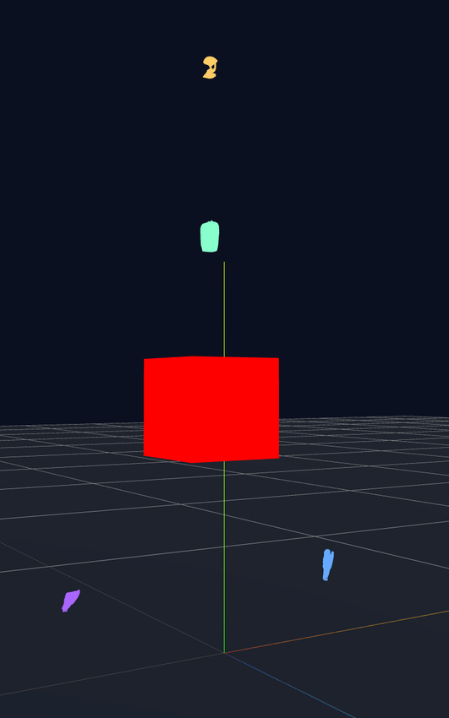
On the other hand, I observed that aligning the robot assets and correctly configuring joint parameters is considerably more complex and time-intensive. This presents a bottleneck when testing multiple policies, as each iteration may require additional adjustments to the model. Furthermore, implementing these configurations in JavaScript adds another layer of complexity compared to traditional Python-based workflows.

Slide 5
In light of these challenges, I chose to utilize the MJSwan libraries for the web implementation. This approach significantly simplifies the process of loading and aligning meshes, as well as integrating the full robot model, compared to building the pipeline from scratch in JavaScript.

Slide 6
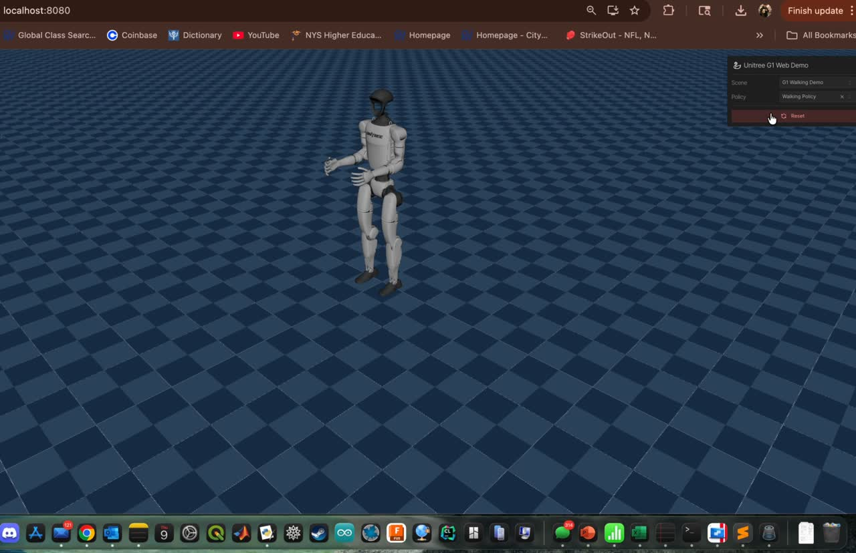
An example of this implementation is shown here. However, further work is required to improve the integration of the policies, particularly to ensure stable and accurate behavior of the robot within the simulation environment.

Slide 7
I believe the next logical step is to develop a generalized platform that requires only a trained policy or model as input to run the simulation. Although this approach may be more complex to implement initially, it offers substantial long-term benefits in terms of scalability, usability, and potential integration into a future course or student-led club.

Slide 8
References
1.MJSwan
https://ttktjmt.github.io/mjswan/
2.ONNX
https://onnx.ai/
3.Three.js
https://threejs.org/

